Slide 1

APEX INSTITUTE OF TECHNOLOGY
DEPARTMENT OF COMPUTER SCIENCE & ENGINEERING
Agile Practices (22CSH-292)
Faculty: Mamta Sharma(E15565)
Lecture1.1: Agile Development
DISCOVER . LEARN . EMPOWER

Slide 2
Learning Outcome of this lecture
CO1 | Understand the Agile Methodology and comparing various other software development models with agile.
CO2 | Examine Scrum and test driven development
CO3 | Apply the various tools available to agile teams to facilitate the project
CO4 | Analyze the method to improve results for a specific circumstance
CO5 | Evaluate likely successes and formulate plans to manage likely risks or problems

Slide 3
Learning Outcome of this lecture
Unit | Name | Outcome
I | Understanding common Agile Practices in DevOps | Introduction to Product Management, Product Design and Requirement gathering, Product Design Challenges, UX Design, Product Development Methodologies, Product Marketing and Presentation, Traditional Software Development Methodologies, Problem/issues with traditional approach, Agile Development, Agile Manifesto, Scrum Model, Agile Estimations and Planning, Soft skills in agile
CO 1 Apply the Agile Methodology and comparing various other software development models with agile
T

Slide 4
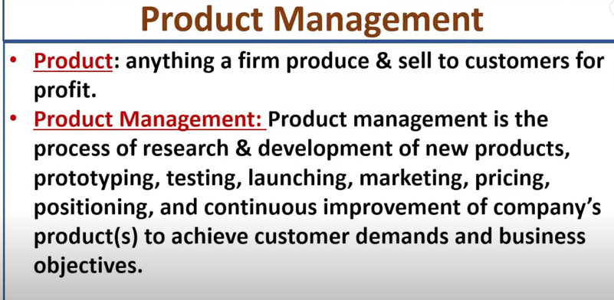

Slide 5
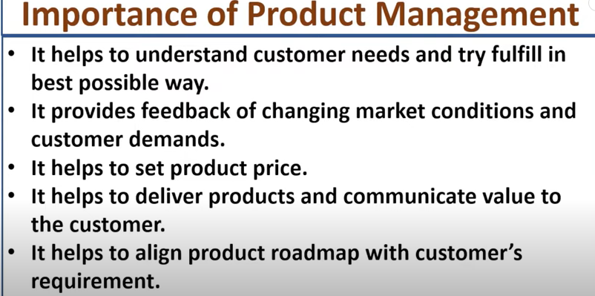

Slide 6
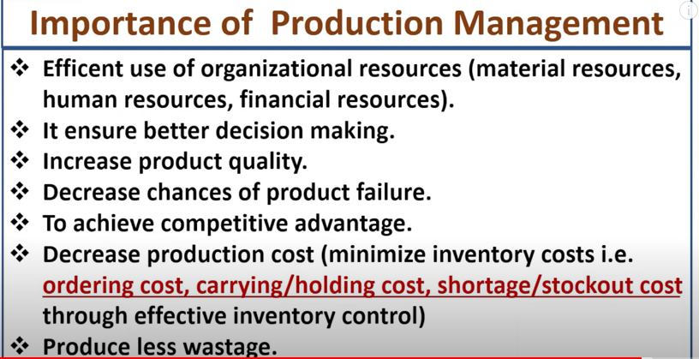

Slide 7
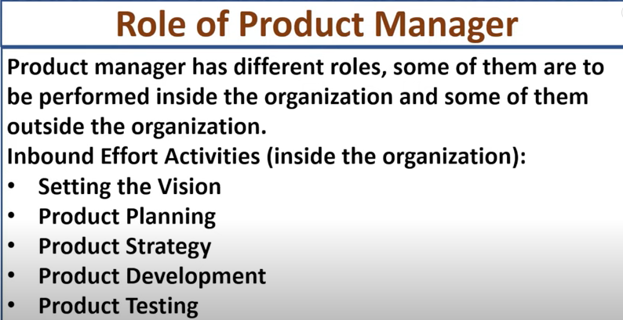

Slide 8
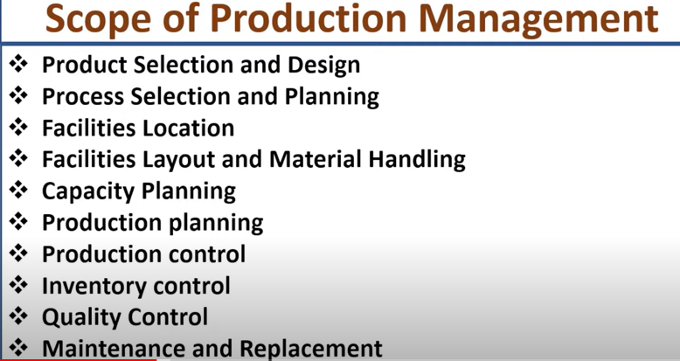

Slide 9
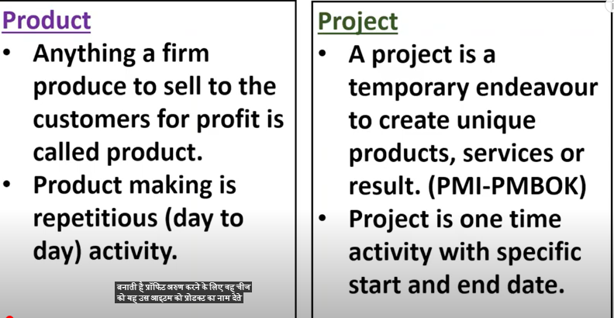

Slide 10
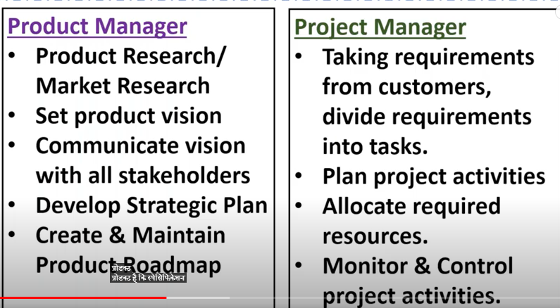

Slide 11
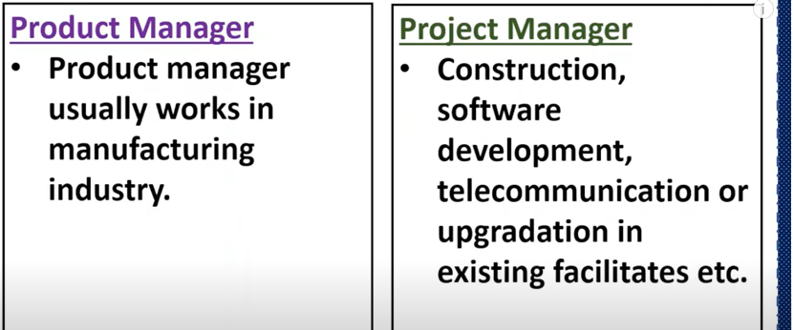
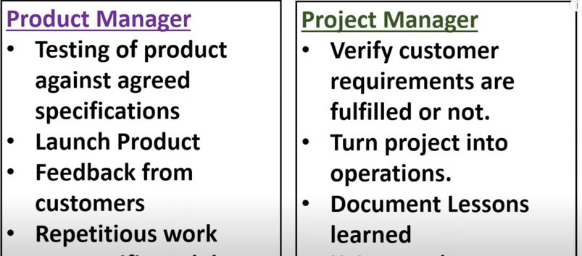

Slide 12
What is Agile Product Management?
Agile product management is about guiding software development, product management through multiple iterations. As agile programs are more fluid than traditional approaches so that agile product management is a more flexible approach.
Agile product managers are more integrated towards technology team than business teams. The product management is supported by the management team and Product Marketing Managers to round out the product discipline. The product manager work over marketing data and business objective.

Slide 13
Product Roadmap:
Definition: A strategic, high-level visual document that outlines the vision, direction, and priorities for a product over time. It communicates the product's intended evolution and aligns stakeholders on the path forward.
It is visual communication tools that’s map the direction of product life cycle
Its is highlight what the product is going to be like in long term future
https://www.youtube.com/watch?v=6U6ghXhB-W4
Product roadmaps provide the overarching vision and strategy, while product routemaps guide the day-to-day execution.
Product managers typically create and maintain roadmaps, while product teams use routemaps to guide their development efforts.

Slide 14
Examples : Product route map
Tasks: Break down features into actionable steps for development teams.
Timelines and Deadlines: Assign specific completion dates to tasks and milestones.
Resource Allocation: Identify the team members, skills, and tools required for each task.
Dependencies: Map out task relationships and potential bottlenecks.
Risks and Mitigation Strategies: Acknowledge potential challenges and outline plans to address them.

Slide 15
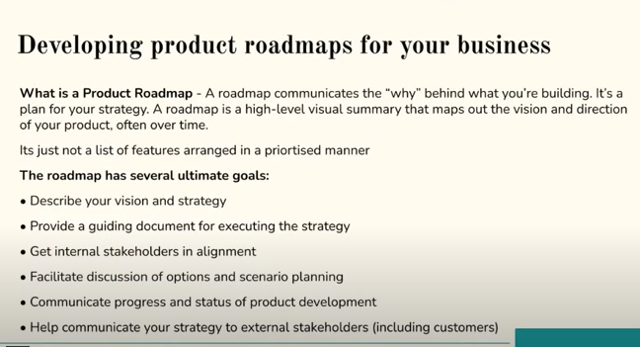

Slide 16
Factor affecting product management
Business: Product management helps teams to achieve their business objective by minimizing the communication gap between product developments, design, the customer, and the company.
User Experience: Product management concentrate on the user experience (UX) that represents the customer within an organization. Better UX is focus manifests itself.
Technology: Product management is a day to day activity in the engineering department. The accurate understanding of computer science is paramount.

Slide 17
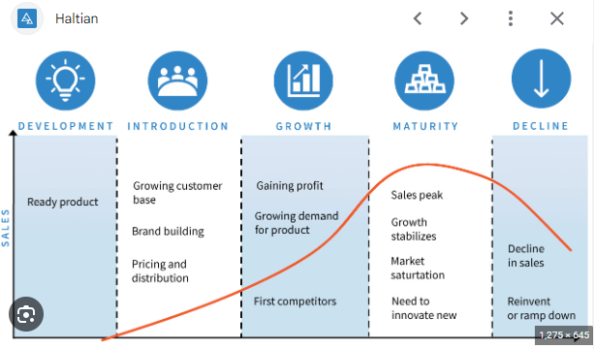

Slide 18
Product development
the process of strategizing, brainstorming, planning, building, and releasing a product to market and then measuring its success. It encompasses taking a product idea from concept to delivery and beyond — so you can grow your business and make customers happy.

Slide 19
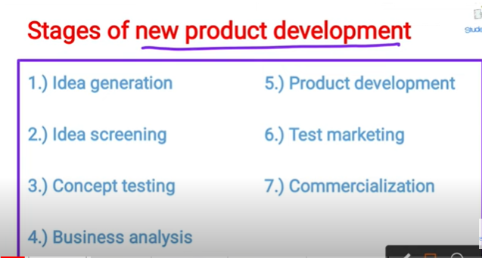
stages of the product development
Idea generation

Slide 20
Stages of product development
Idea Generation:
Significance: This is the inception phase where product ideas are brainstormed. Ideas can come from various sources, including customer feedback, market trends, competitive analysis, or internal team discussions.
Idea Validation:
Significance: Before committing resources, it's crucial to validate the feasibility and market demand for the proposed product. This stage helps in reducing the risk of investing in an unviable idea.

Slide 21
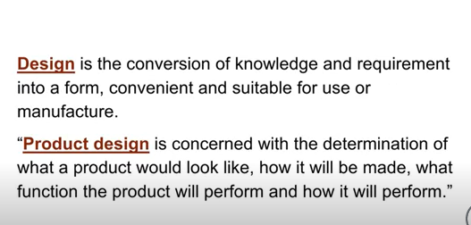
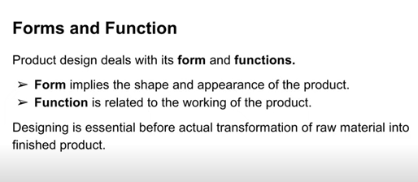
Product design

Slide 22
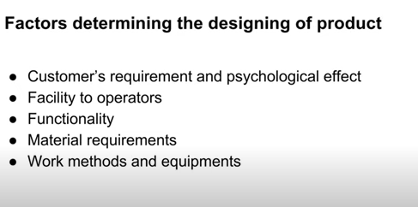
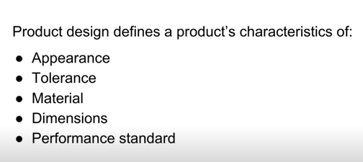
Product design characteristics and factors

Slide 23
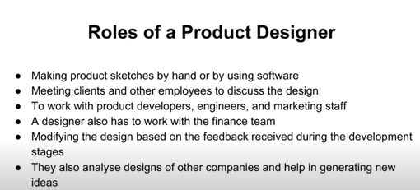

Slide 24
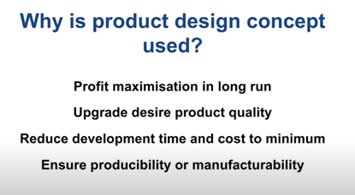

Slide 25
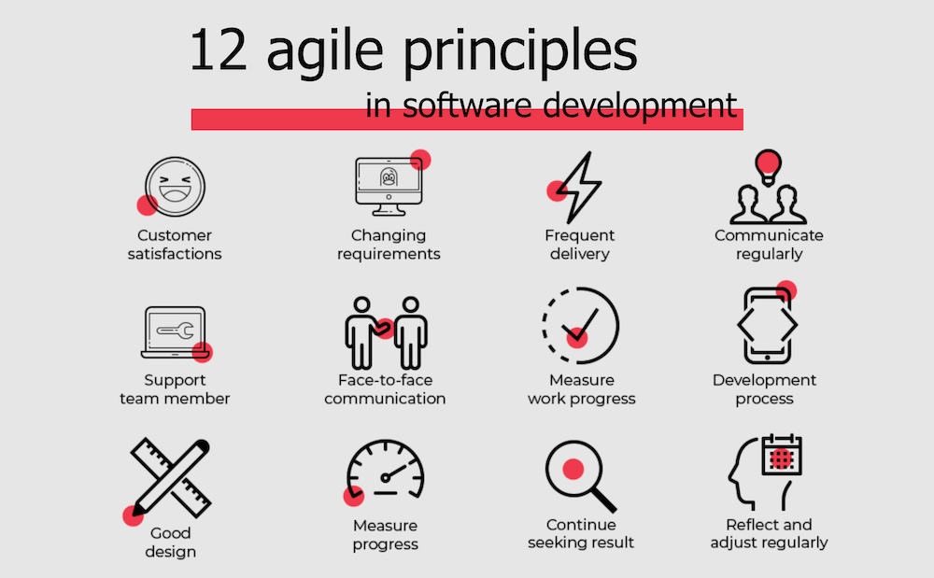
AGILE MANIFESTO

Slide 26
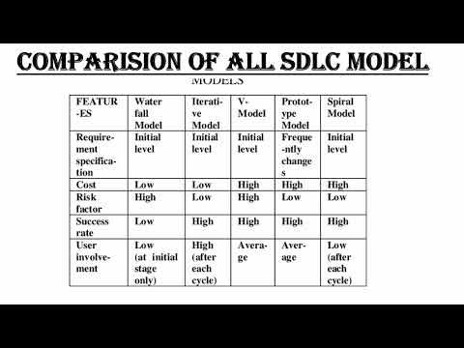

Slide 27
Text Books and Reference Books
T1 Agile Project Management with Kanban - Book by Eric Brechner
T2 Agile Foundations: Principles, Practices and Frameworks – Peter Measey
Reference Books:
1 Agile Project Management with Kanban Eric Brechner 2nd Microsoft Press 2021
2 Agile Foundations Peter Measey(4th BCS,) The Chartered Institute for IT 2015

Slide 28
References
https://www.mygreatlearning.com/blog/importance-of-design-thinking/
https://www.interaction-design.org/literature/article/5-stages-in-the-design-thinking-process
https://en.wikipedia.org/wiki/Design_thinking

Slide 29
THANK YOU
For queries
Email: mamta .e15565@cumail.in

